Slide 1
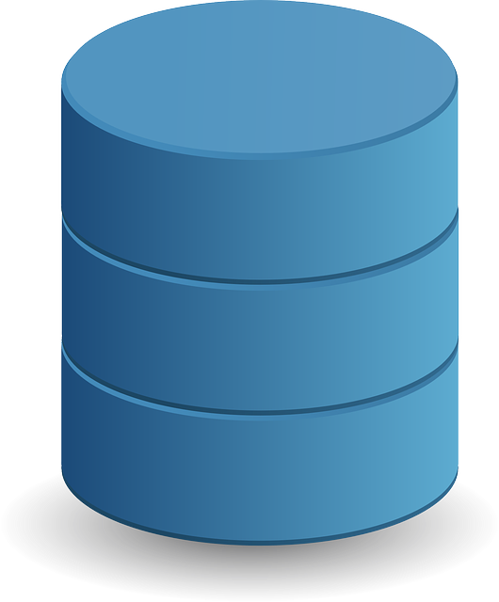
Appli-
cation
API
App
MongoDB
Driver
React
Express
Browser
Node.js
MongoDB
Client Machine
Back-end server

